Slide 1
Into the Shopping Basket
A brief presentation on the Analysis Report “Intro the Shopping Basket”
By: Merrett Brewer & Sarath Ravi

Slide 2
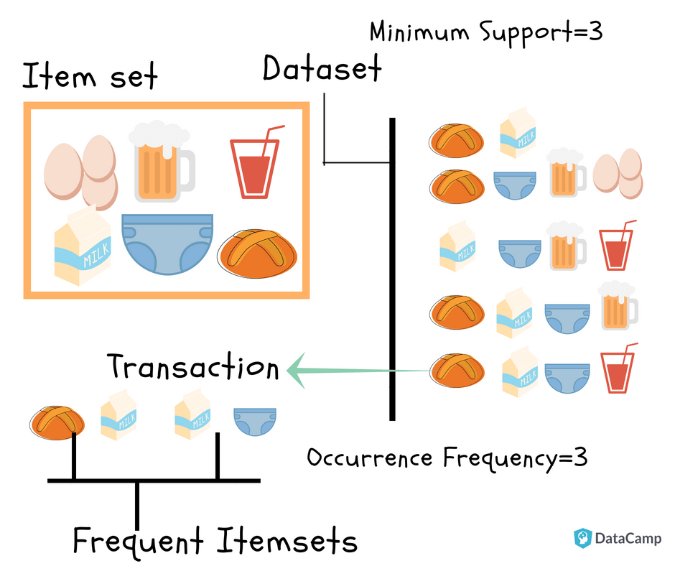
Market-Basket Analysis
Notes:
As you may be able to tell from the image on this slide - Market Basket Analysis is tactic used to determine which products are most often purchased together. Market-basket analysis is an important strategy for businesses/marketers to take into consideration. Depending on which products result in frequent purchases togethers strategies can be implemented to increase these sales.

Slide 3
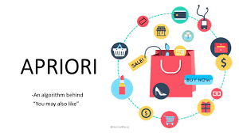
Types of Algorithms used for Market-Basket
#1
Notes:
Apriori algorithm is one of the most common algorithms utilized for Market-Basket research. The algorithm utilizes association rule learning, a machine learning tactic, that checks for the dependencies between variables being true. This is beneficial in Market-Basket analysis because it goes over the data through multiple passes and places all variables that appear together most often into larger data sets.

Slide 4
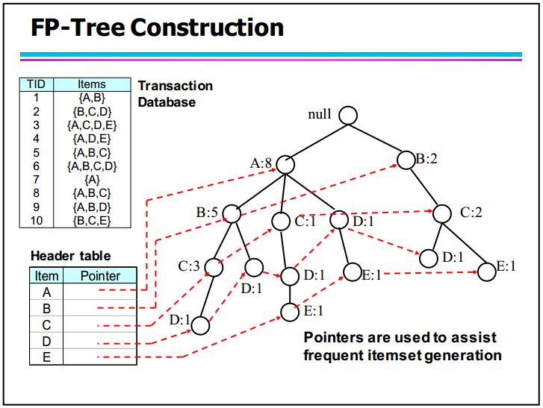
FP-Growth
Notes:
FP-Growth analysis takes into consideration much of what Apriori does, however the algorithm only takes two passes over the data. This strategy is becoming more favored in Market-basket analysis as it saves on time. Once the variables that are purchased together is produced this information is utilized to create a FP-Tree, as seen in the image on this slide.

Slide 5
Our Analysis
We utilized the following data set:
Purchase data from December 2018 - December 2021 from a medium sized jewelry store
We used these data sets to run Apriori and FP-Growth algorithms in Python
Notes:
*Read Slide*...”Our analysis included the initial selection of data suitable for Market-Basket analysis, then data cleaning and transformation to ensure this data could be ran in python and produce accurate results. Furthemore, a sample of 1% was chosen from each dataset and ran through both the Apriori and FP-Growth algorithms.

Slide 6
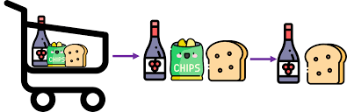
THE RESULTS
Using our results (attached in a link provided in the references slide) we determined that the FP-Growth algorithm is the best approach for Market-Basket analysis.
We came to this conclusion due to the support count, confidence measure, and execution time displayed by the FP-Growth algorithm in each instance in comparison to that of the Apriori algorithm.
Notes:
The FP-Growth algorithm displayed greater results regarding support count, confidence measure, and execution time. These indepth results can be seen in the analysis report attached on the reference page of this presentation.

Slide 7
REFERENCES
“Into the Shopping Basket” https://docs.google.com/document/d/14B3rqj1dvUwAkigLutlYYp41rikJo38v_hYQ4ASxV8g/edit?usp=sharing
https://www.analyticsvidhya.com/blog/2021/10/a-comprehensive-guide-on-market-basket-analysis/
https://indjst.org/download-article.php?Article_Unique_Id=INDJST6661&Full_Text_Pdf_Download=True
https://www.ijcsmc.com/docs/papers/June2015/V4I6201552.pdf
https://citeseerx.ist.psu.edu/document?repid=rep1&type=pdf&doi=608667cc9f2a5517a7bf2995beb5bbc4e1709eef
https://s2.smu.edu/~mhd/pubs/00/ar.doc

